Slide 1
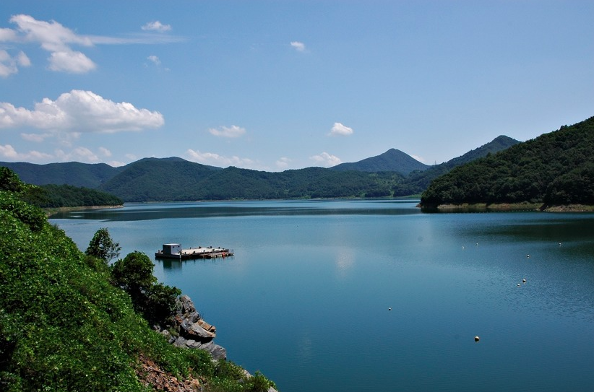
Improving On-site Reservoir Operation Policies by Robust and Adaptive Optimization Models
Gi Joo KIM
Institute of Construction and Environmental Engineering
Seoul National University
Photo Credit: https://blog.daum.net/lko62519/8739590
Notes:
자기소개
& Summary of the PhD Dissertation I presented last year in my final defense.

Slide 2
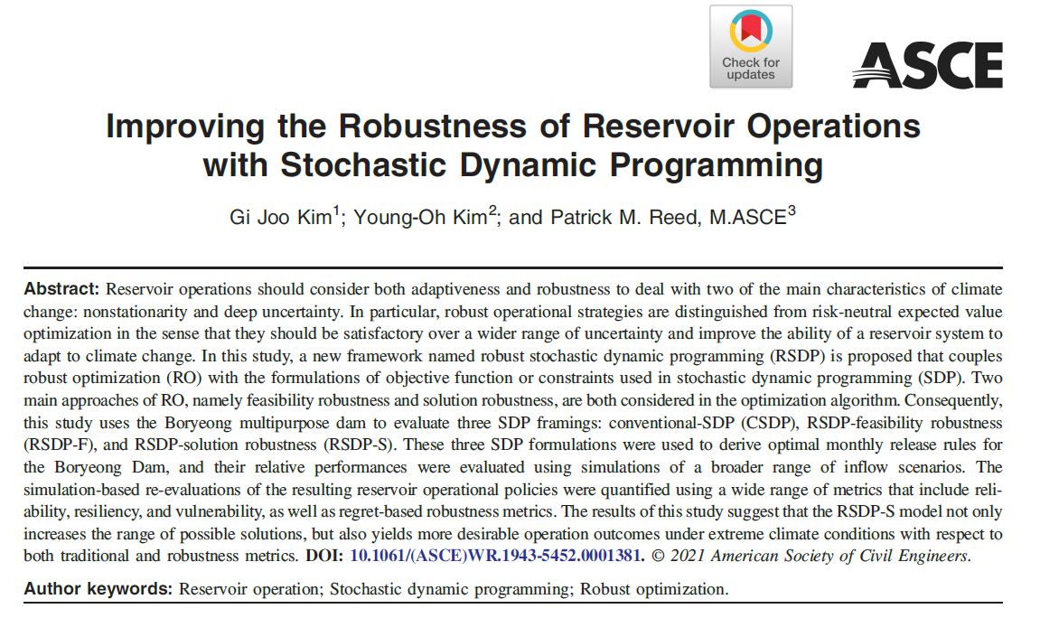
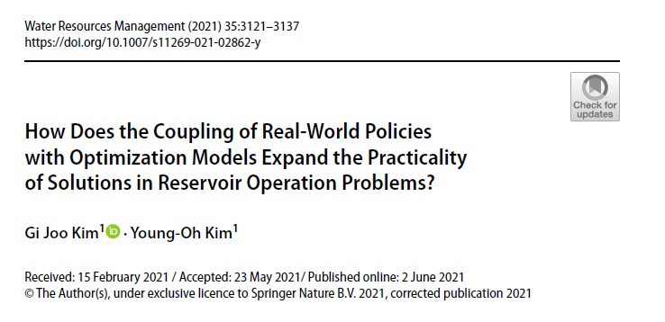
<Improving On-site Reservoir Operation Policies by Robust and Adaptive Optimization Models>
C4. Coupling Hedging Rules with Optimization Models in Reservoir Operation Problems (Kim & Kim 2021)
C5. Reforming the Hedging Rules with Adaptive Operations against Multi-year Droughts (currently in press)
C6. Improving the Robustness of Reservoir Operations with Stochastic Dynamic Programming (Kim et al. 2021)
Notes:
My dissertation is titled “Improving On-site Reservoir Operation Policies by Robust and Adaptive Optimization Models”, and in today’s presentation I will be covering chapters 4 and 6 briefly, and will present mainly focusing on chapter 5 which was recently accepted and in press under the journal Water Resources Management.

Slide 3
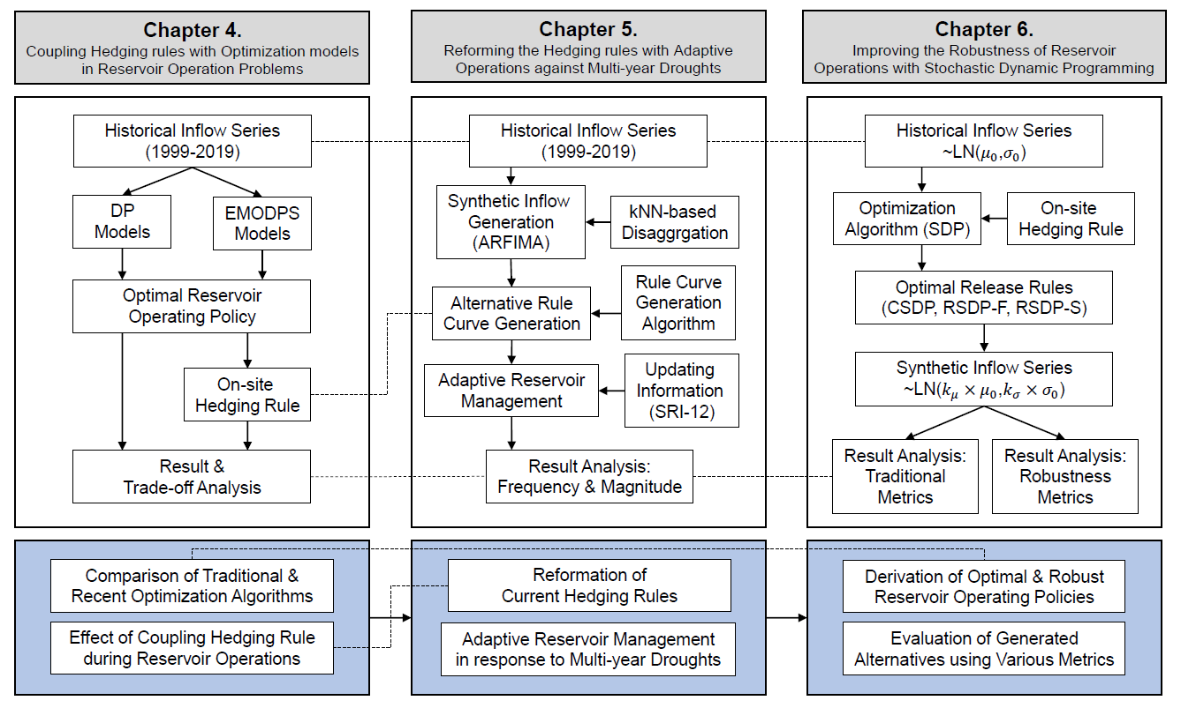
Notes:
The following figure shows the overall flowchart of the dissertation. Although each study in the dissertation are separately conducted, the tools utilized in the dissertation and the outcomes from each study are interconnected, and they are expressed in the figure.

Slide 4
C4. Coupling Hedging Rules with Optimization Models in Reservoir Operation
How does different optimization models or their formulations affect both the quality and the diversity of solutions in reservoir operation problems?
How about when the reservoir was operated with the status quo (SQ) rules? How do they perform under both drought and normal conditions compared to optimal solutions?
How does the implementation of SQ rules with the solutions from optimization algorithms improve (or degrade) the performance under extreme drought conditions?
Notes:
I recall presenting this topic in the group meeting last year, but let me briefly summarize this chapter as it is closely connected to today’s main presentation.
The key research questions of this chapter is divided into these three:

Slide 5
C4. Coupling Hedging Rules with Optimization Models in Reservoir Operation
2-Obj. Optimization Models for Optimal Reservoir Operations
Dynamic Programming-based Models with different information
Deterministic DP-Perfect (DDP-Perfect)
Deterministic DP-Monthly Average (DDP-Average)
Stochastic DP (SDP): Assuming lognormal distribution of inflows
Evolutionary Multi-Objective Direct Policy Search (EMODPS) Models with different RBF shapes & number of parameters
EMODPS-Linear: Linearly shaped RBF with 4 policy parameters
EMODPS-Gaussian: Gaussian shaped RBF with 3 policy parameters
EMODPS-Root: Root shaped RBF with 6 policy parameters (j=2)
Notes:
The optimization models with the two objectives are formulated using the dynamic programming model with different information: perfect forecast, monthly average forecast, and stochastic model assuming lognormal distribution of inflows. The EMODPS models were also formulated with different shapes and number of parameters of the RBFs

Slide 6
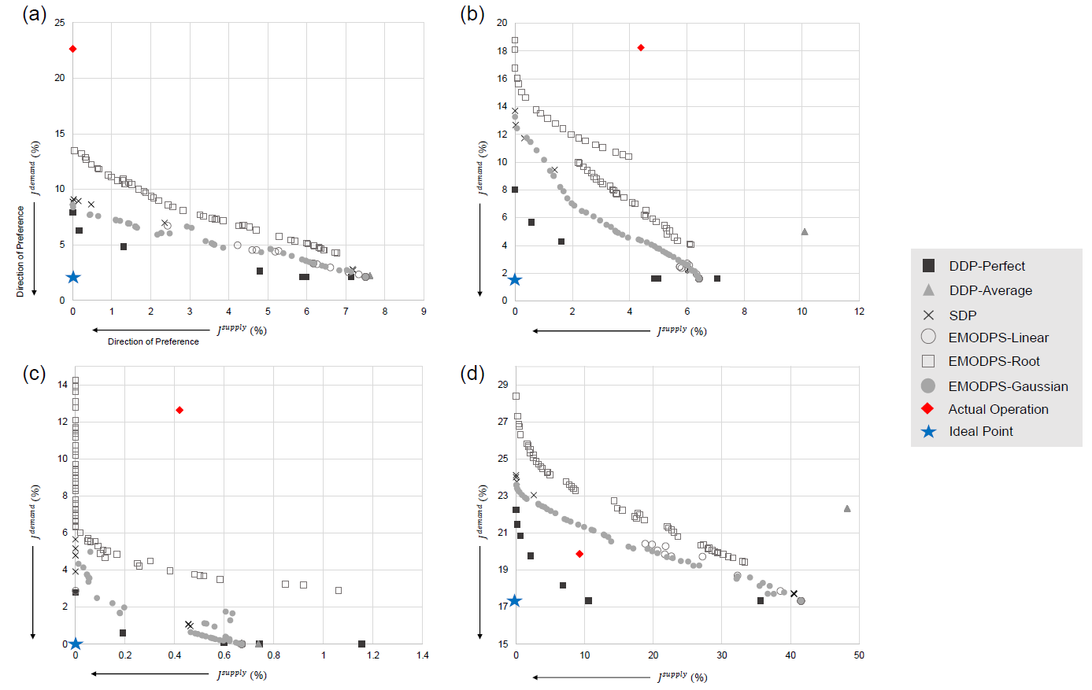
C4. Coupling Hedging Rules with Optimization Models in Reservoir Operation
Notes:
This figure demonstrates the Pareto fronts derived from each of the subgroups of the k-fold cross validation. In most of the cases, the EMODPS-Gaussian model yielded the best possible results regarding the proximity to the ideal points and solution diversity.

Slide 7
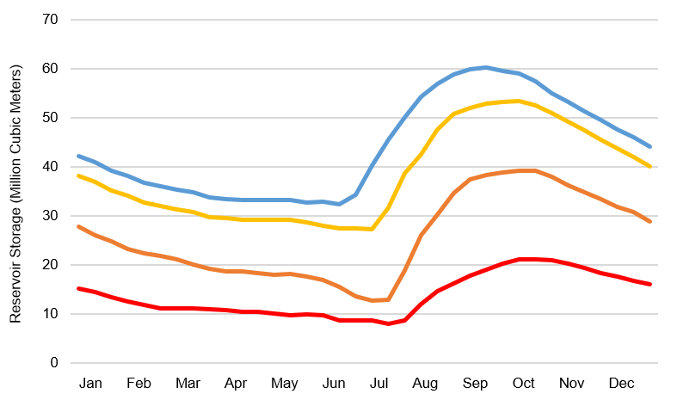
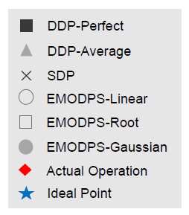
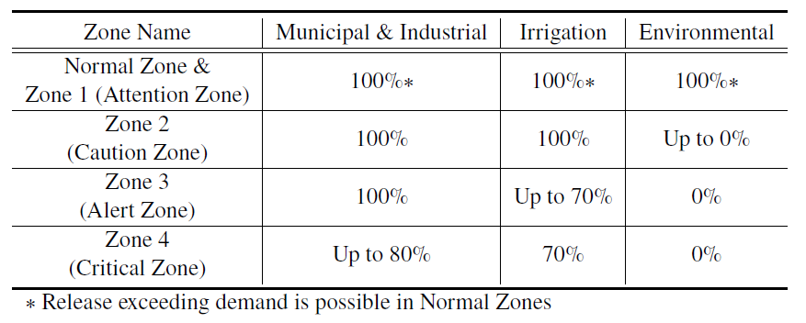
C4. Coupling Hedging Rules with Optimization Models in Reservoir Operation
During simulation, real-world reservoir operating policy is coupled with the best performing optimization model: EMODPS-Gaussian
Normal Zone
Zone 1
Zone 2
Zone 3
Zone 4
Fig. 9. Actual Rule Curves of Boryeong Reservoir, Korea
Table 3. Ratios implemented during hedging
Notes:
For the last portion of this study, one of the EMODPS model, EMODPS-Gaussian is then coupled with the actual zone-based hedging rule during simulation. Then, their performance under the drought conditions were tested and analyzed in terms of frequency, duration, and magnitude.

Slide 8
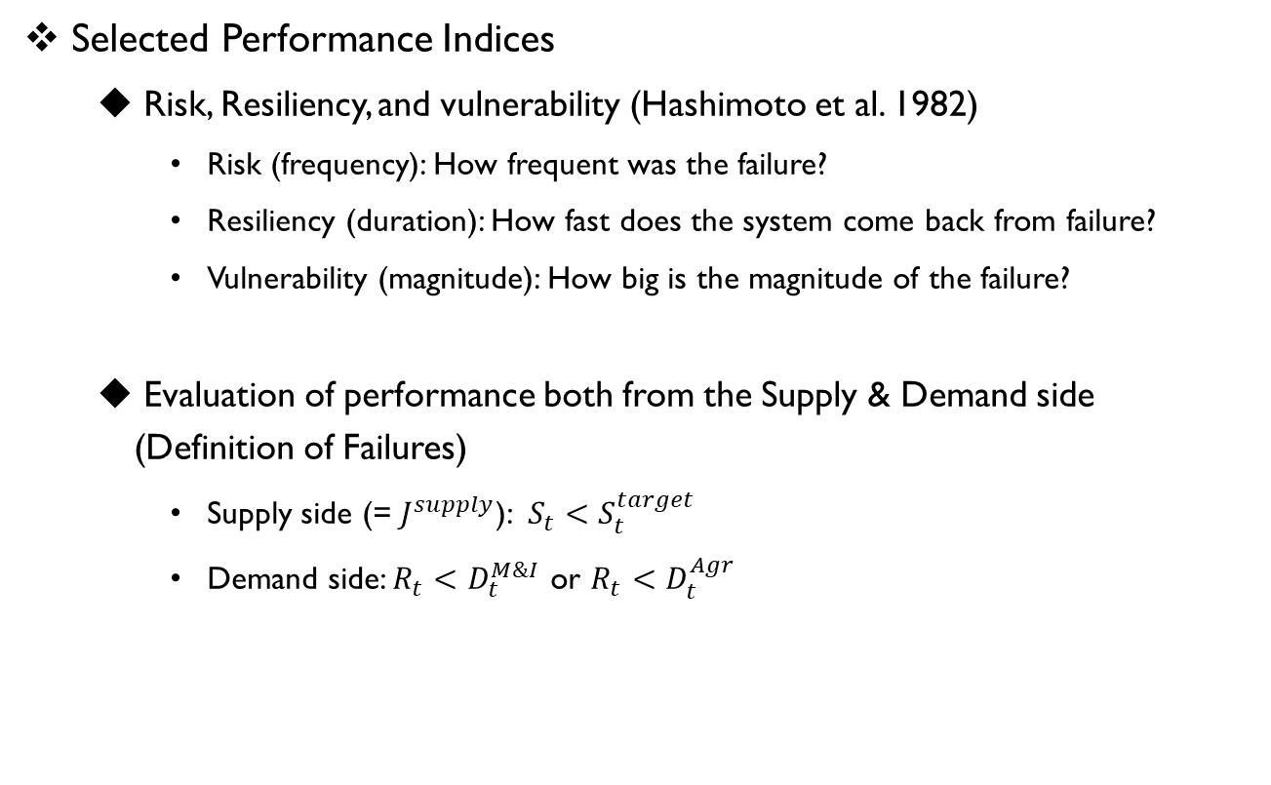
C4. Coupling Hedging Rules with Optimization Models in Reservoir Operation
Selected Performance Indices
Risk, Resiliency, and vulnerability (Hashimoto et al. 1982)
Risk (frequency): How frequent was the failure?
Resiliency (duration): How fast does the system come back from failure?
Vulnerability (magnitude): How big is the magnitude of the failure?
Evaluation of performance both from the Supply & Demand side (Definition of Failures)
Supply side (= $J^{supply}$): $S_{t}<S_{t}^{target}$
Demand side: $R_{t}<D_{t}^{M\&I}$ or $R_{t}<D_{t}^{Agr}$
Notes:
In this section, the concepts of FDM were utilized to measure the system’s performance in both supply side and the demand side. In the demand side, the failure was divided into different water usages.

Slide 9
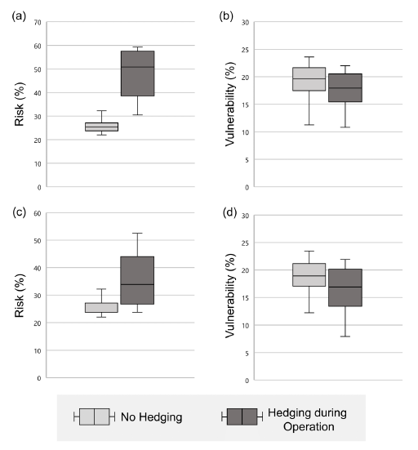
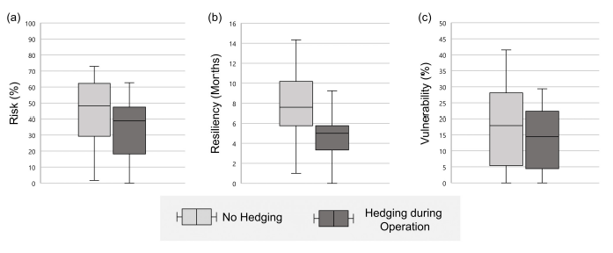
C4. Coupling Hedging Rules with Optimization Models in Reservoir Operation
*Risk Aversion*
Fig. 10. Performance indices measured from the supply side: (a) risk, (b) resiliency, and (c) vulnerability
Coupling of zone-based hedging rule with the solutions from the optimization models resulted in outcomes favorable to risk-averse real-world water users (may hold promise)
Fig. 11. Performance indices measured from the demand side: (a) risk of water for A uses, (b) vulnerability of water for A uses, (c) risk of water for M&I uses, (d) vulnerability of water for M&I uses,
Notes:
This result shows that coupling hedging betters the performance measured from the supply side. Although the degrading performance in the demand side is expected, we could observe the trade-off relationship between risk and vulnerability.
((ANIMATION)) Also, given the risk aversing nature of the water users, it can be concluded that the outcomes of coupling the hedging rules during operation hold promise and may be extended with further studies.

Slide 10
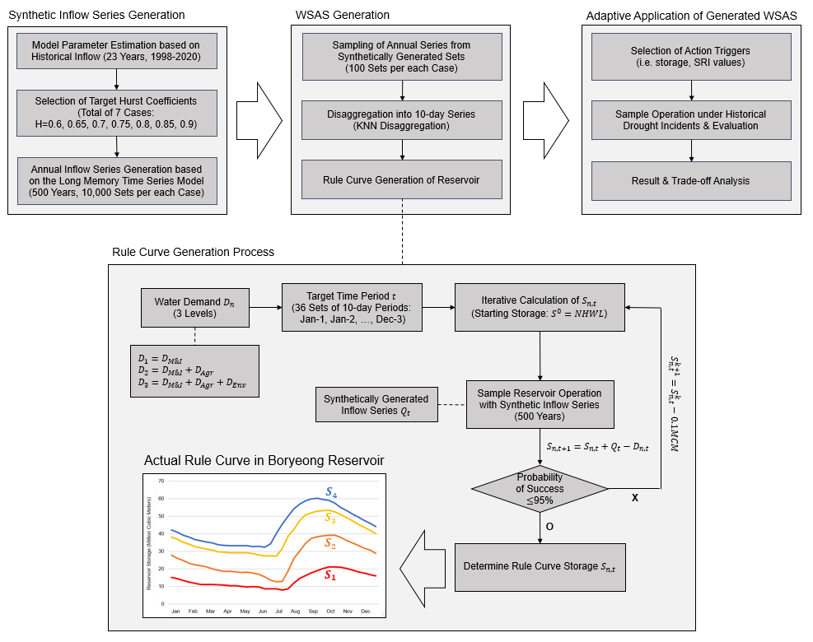
C5. Reforming the Hedging Rules with Adaptive Operations against Multi-year Droughts
Keywords: Zone-based hedging rule, K-nearest neighbor disaggregation, Adaptive reservoir operations, Multi-year drought
Notes:
The second case study includes a method in which the SQ rules are reformed against multi-year droughts and operated under adaptive concepts.

Slide 11
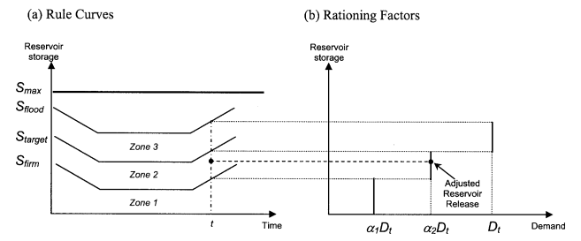
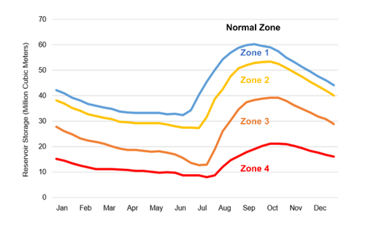
Methodology: Hedging Rules
Standard operating policy (SOP): release water as close to the target demand as possible (saves only surplus water for future delivery)
Hedging (rationing operation) for reservoir operations
Provides only a portion of the target when greater release is possible
Types of hedging rules: One-point, two-point, discrete (zone-based), …
Fig. 1. Concept of zone-based hedging in reservoir operations, adopted from Tu et al. (2008)
Notes:
보령댐도 실제로는 이 중 하나인 Zone-based hedging rule에 기반해서 운영되고 있음을 설명
The first methodology this study includes is the hedging rules. Differently from the standard operating policy where meeting the demand is the primary objective under all circumstances, hedging, or rationing operations, provides only a portion of the target even when greater release is possible. The figure below shows a type of hedging rule, zone-based hedging rule where the release is determined according to the storage level of the reservoir.

Slide 12

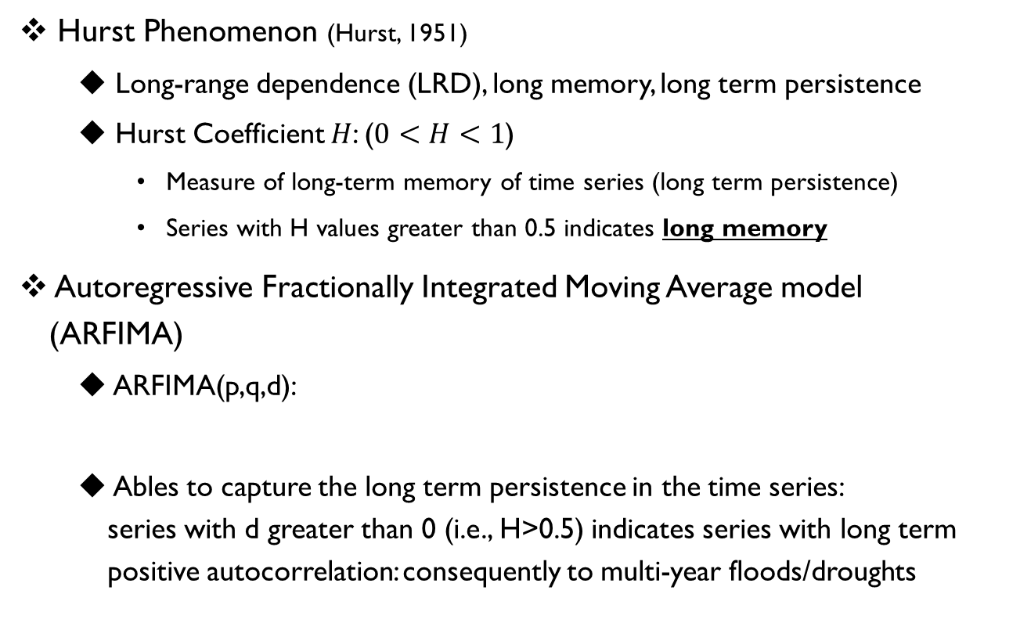
Methodology: Long Memory Time Series Generation
Hurst Phenomenon (Hurst, 1951)
Long-range dependence (LRD), long memory, long term persistence
Hurst Coefficient $H$: ($0<H<1$)
Measure of long-term memory of time series (long term persistence)
Series with H values greater than 0.5 indicates long memory
Autoregressive Fractionally Integrated Moving Average model (ARFIMA)
ARFIMA(p,q,d):
Ables to capture the long term persistence in the time series: series with d greater than 0 (i.e., H>0.5) indicates series with long term positive autocorrelation: consequently to multi-year floods/droughts
$$d=H−1/2$$
AR Term
MA Term
B: Backshift Operator
Notes:
The second methodology in this study is the long memory time series generation. We focused on the concept of the Hurst Phenomenon, which stresses long term persistence in the time series. The measure of the long memory is the Hurst coefficient, in which the value greater than 0.5 indicates long memory.
((ANIMATION)) For incorporation of long memory, the autoregressive fractionally integrated moving average model was selected in which the coefficient d holds information regarding the long-term persistence.

Slide 13
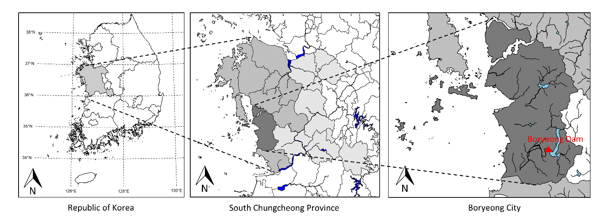
Case Study: Boryeong Multipurpose Reservoir
Watershed Area: 2,860 km²
Water Supply Districts (8, Light Gray) Boryeong (Dark Gray), Seosan, Dangjin, Seocheon, Cheongyang, Hongseong, Yesan, Taean
Water Use: 106.6 MCM/year (Reservoir Capacity: 116.9 MCM) (Municipal & Industrial water demand: 84%, Agricultural water demand: 5%, Environmental water demand: 11%)
Notes:
Two main notable characteristics 1) small difference between the annual water use and the reservoir capacity,
2) And the high ratio for M&I water demand the reservoir is responsible for.

Slide 14
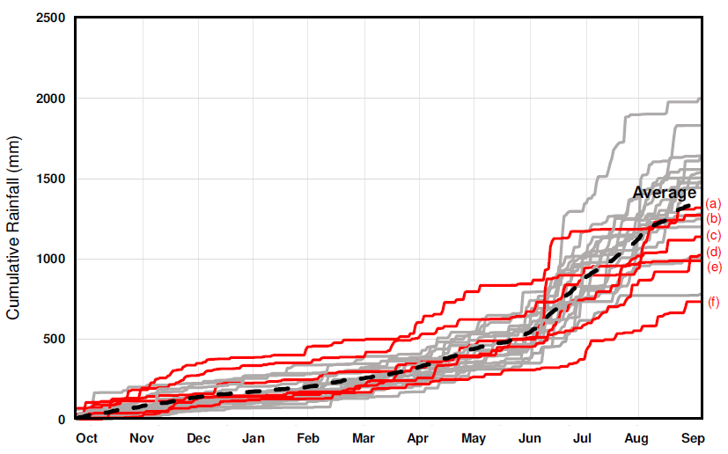
Case Study: Boryeong Multipurpose Reservoir
Recent Multi-year Drought in Boryeong Dam Basin (2014-2019)
Consecutive decrease in the total annual precipitation (6 water years)
Both structural/non-structural measures to mitigate the effects from the long-lasting drought
Conduit Construction Project (2016-2017, $62,500,000+$2,600,000/year)
Enforcement of Pressure Reduction in Water Supply Systems (127 days)
(a)~(f): cumulative rainfall during water years 2013-2014 through 2018-2019
29% Decrease
In Total Inflow (2015-2017)
Inflow (cms)

Slide 15
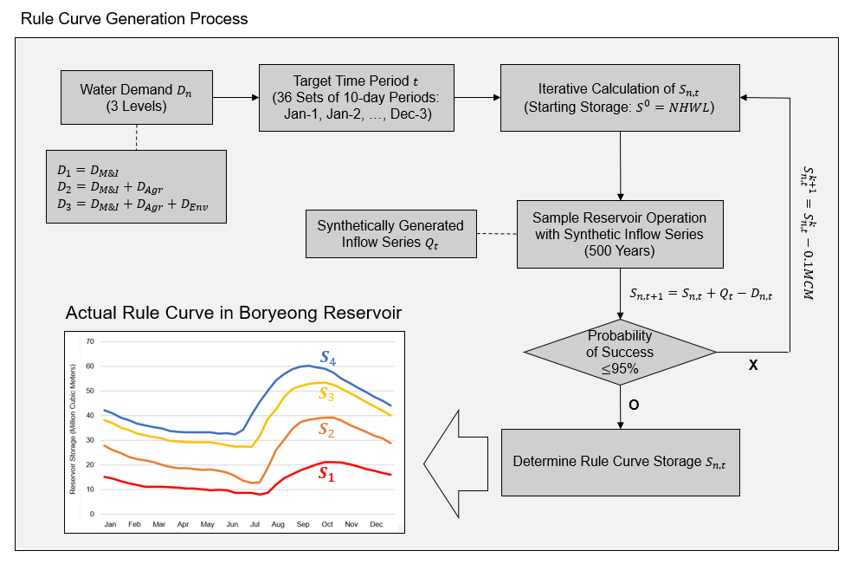

Application: SQ Rule Generation Algorithm
Inclusion of Long Memory Time Series during rule curve generation
Statistics of synthetically generated inflow series
Average, standard deviations: Identical to historical statistics
7 Cases of Long persistence (H = 0.6, 0.65, 0.7, 0.75, 0.8, 0.85, 0.9)
$$Q_{t,H}$$
Stronger Long Memory
Fig. 2. Iterative calculation process of determining the storages in each zones
Notes:
For the application process, a total of seven cases of synthetic inflow series were generated. While keeping the average and the standard deviations constant with the historical statistics, ((ANIMATION)) seven cases of synthetic inflow series were generated and utilized during the rule curve generation process.
The procedures for the hedging rule generation is demonstrated in the figure. Iterative simulations of the reservoir for 500 years is conducted with the prespecified inflow and demand, and the lowest storage value that satisfies the 95% percentile is selected as the storage corresponding to the rule curve.

Slide 16
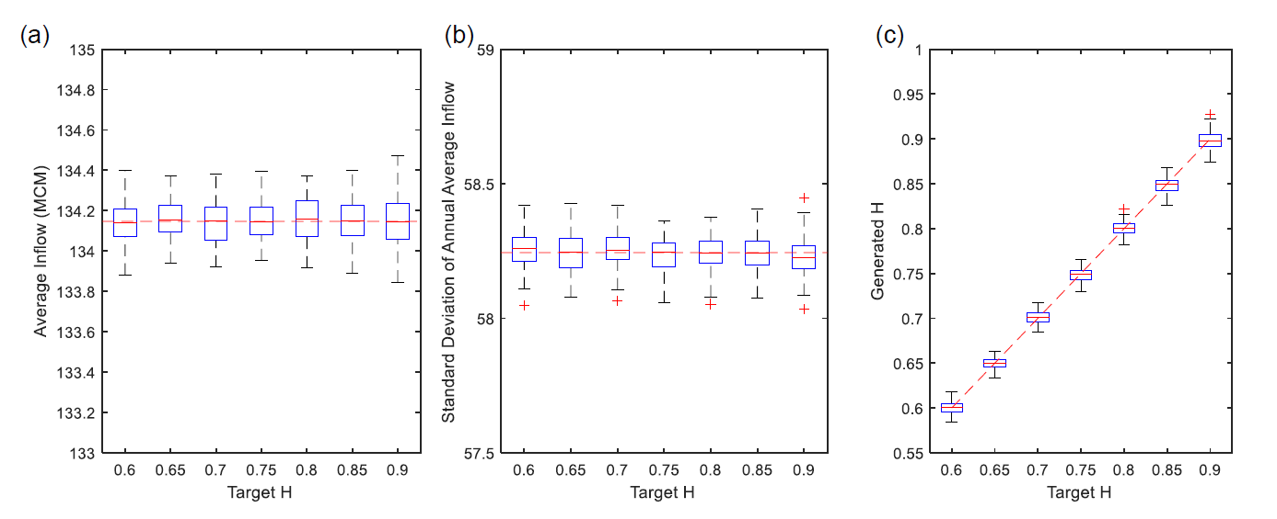
Results: Synthetic Inflow Generation
Generation of Annual Series with different long term persistence
Disaggregation from Annual series to 10-day series
Utilization of K-nearest neighbor (KNN) Disaggregation (Nowak et al. 2010)
Preserves the distributional statistics (i.e., mean, variance, skewness, and minimum & maximum values) of the historical records
Fig. 3. Statistics of the generated annual inflow series with long memory: (a) average, (b) standard deviation, and (c) Hurst coefficient
Notes:
This slide shows the results for the synthetic inflow generation. After generating the annual series of 500 years, they were disaggregated using the K Nearest Neighbor disaggregation method in which the distributional statistics of the historical records were preserved.

Slide 17
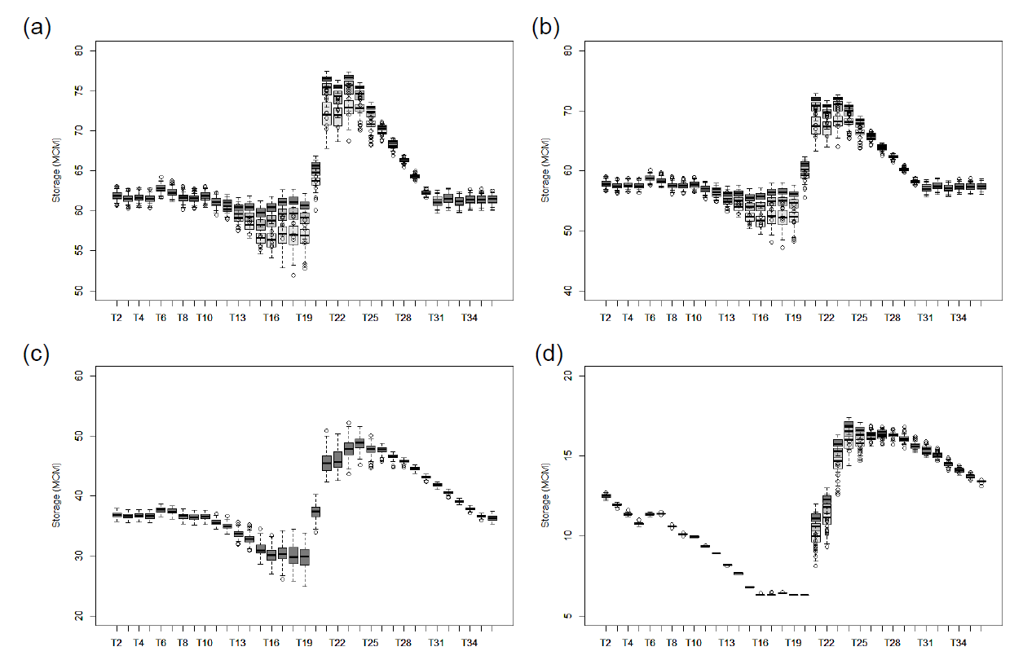
Results: SQ Rule Formulations
Iterative calculations for rule curve generation
100 Sets of 500-year series for more robust rule curve storage values
Fig. 4 shows 3 representative cases where darker = stronger long term persistence (H=0.6, 0.75, 0.9)
Fig. 4. Generated alternative storage zones: (a) zone 1 (b) zone 2 (c) zone 3 (d) zone 4 (attention-caution-alert-critical)
Notes:
With the disaggregated inflow series, the rule curves were generated using 100 sets of 500-year series. The figure shows zone 1, 2, 3, and 4 curves where darker boxplots indicates curves generated with stronger long-term persistence inflow series.

Slide 18
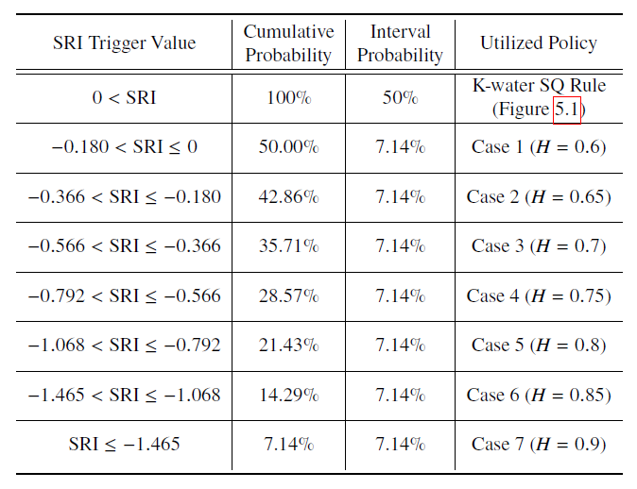
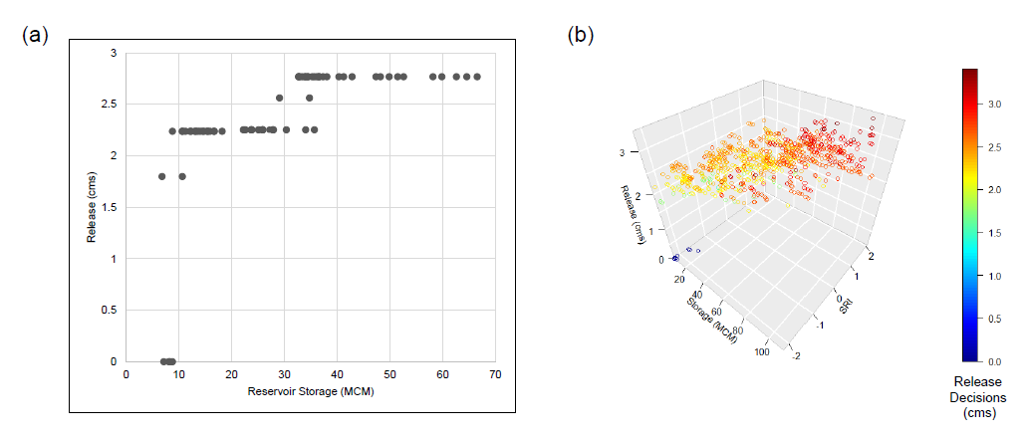
Results: Adaptive RO with Alternative Rules
Adaptive Reservoir Operations with Alternative Rule Curves
Adaptive (or dynamic) DM = decisions are iteratively updated by the results of its previous outcomes and new information (Kolokytha et al. 2017)
Selected Trigger: Standard Runoff Index (SRI) 12
Notes:
The alternative rule curves generated from this study were then applied with adaptive, or dynamic, decision making technique. This study refers to adaptive decisions as decisions that are iteratively updated by the results of its previous outcomes and also new information. Therefore, in addition to the storage values this study selected SRI-12 as another trigger and utilized the policy according to the standards in the table.
((ANIMATION)) Compared to the SQ operations in which relatively simple release rules in only feasible, the adaptive operation proposed in this study diversifies the release decisions according to both the storage and the SRI values.

Slide 19
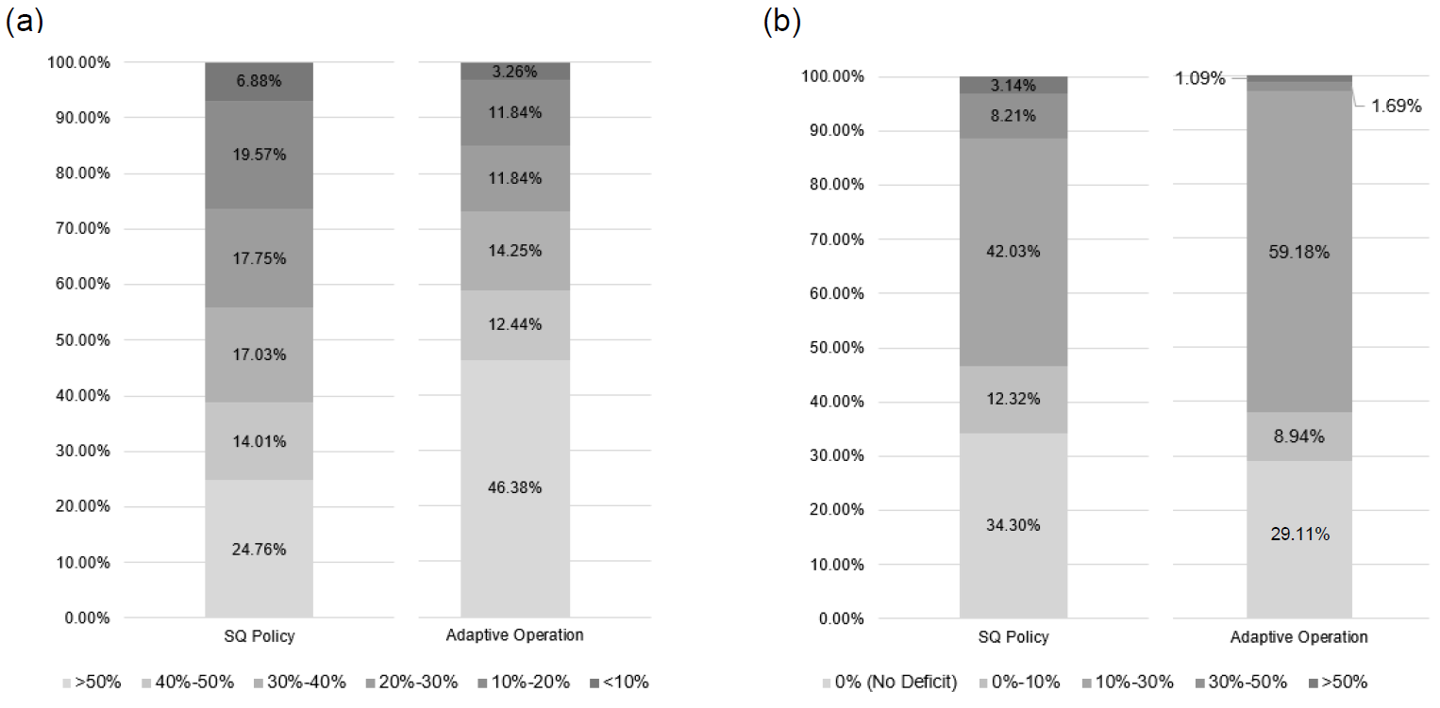
Results: Adaptive RO with Alternative Rules
Reservoir Simulation Comparison (under historical inflow, 1998-2020) K-water SQ Rule vs. Adaptive Operations (proposed in this research)
Supply (a): Storage (%), darker columns indicate lower storage
Demand (b): Water Deficit Ratio (%), darker columns indicate greater water deficit ratio
Critical Failures (>30%):
SQ 11.35% vs AO 2.78%
Overall Reliability:
SQ 34.30% vs AO 29.11%
Fig. 6. Performance Comparison of the two policies: (a) supply side performance (b) demand side performance
Notes:
Two rules were simulated under historical inflow of 1998 through 2020. They were once again evaluated in terms of supply, or storage, and demand, or water deficit ratio.
((ANIMATION)) This figure shows the performance of the two policies.
((ANIMATION)) First, the results from the adaptive operations yielded better results measured in terms of storage. ((ANIMATION)) ((ANIMATION)) Secondly, in terms of overall reliability, the K-water SQ rules were slightly better than the adaptive operations, and finally, ((ANIMATION)) the frequency of the critical failures dramatically decreased under adaptive operations.

Slide 20
Summary & Conclusion
Reformed SQ Policy (Alternative rule curves)
Variability of the resulting policy mostly during the flooding seasons (T13-T25, May-01 through Sep-10)
Stronger long memory inflow series leads to higher (or more conservative rule curve values, especially in zones 1, 2 & 4)
Adaptive RO with Alternative Hedging Rules
Adaptive application of alternative rule curves based on the updating information: SRI-12 values to account for long-term droughts
Enables more flexible release decisions
Adaptive operations simulations under historical droughts decreased the frequency of critical failures
Can be utilized especially under extreme drought conditions
Notes:
For summary, the different long-term persistence was revealed mostly during the flooding seasons, especially through May to September. Also, curves generated with stronger long memory led to higher, or more conservative rule curves in zones 1, 2 and 4.
((ANIMATION)) Moreover, the alternative rule curves were utilized in adaptive operations, in which the decisions are updated with SRI values. Under adaptive operations, more flexible decisions were possible and also the frequency of critical failures decreased which can be further utilized under extreme drought conditions in future operations.

Slide 21
C6. Improving the Robustness of Reservoir Operations with Stochastic Dynamic Programming
Stochastic Dynamic Programming
Robust Optimization (Mulvey et al. 1995)
: Continuity Equation
: Recursive Equation
: Feasibility Constraint
*
Subject to:
: Robustness Objective Function
Measure of how much the control constraint is violated in RO
Notes:
Stochastic dynamic programming is a specific type of dynamic programming model, in which the release decisions are decided based on the iterative calculation results of the recursive equation.
((ANIMATION)) This dissertation aims to couple the stochastic dynamic programming with robust optimization, as demonstrated in the equations below. The objective function in the RO model includes the robustness penalty function that measures the amount of the constraint violation.

Slide 22
C6. Improving the Robustness of Reservoir Operations with Stochastic Dynamic Programming
Two concepts of Robustness
Feasibility robustness: range of search for a potential solution is expanded by the use of soft constraints and corresponding penalty term
Solution robustness the variance of the initial objective is penalized according to the distance from either its best value or its most frequent value
Couples key components of RO into the objective function and constraints of SDP (Both feasibility and solution robustness)
: Robustness Objective Function
: Robust Feasibility Constraint
Notes:
More specifically, the concepts of robustness included in the RO model can be classified into feasibility and solution robustness. Whereas the feasibility robustness extends the range of potential solutions with soft constraints and corresponding penalty term, solution robustness penalizes the variance of the initial objective from its best or most frequent values.
((ANIMATION)) Because these features are easily implementable into the model formulation of the dynamic programming models, both concepts are incorporated into the SDP model to form RSDP-F and RSDP-S models.

Slide 23
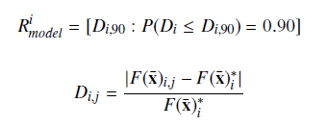
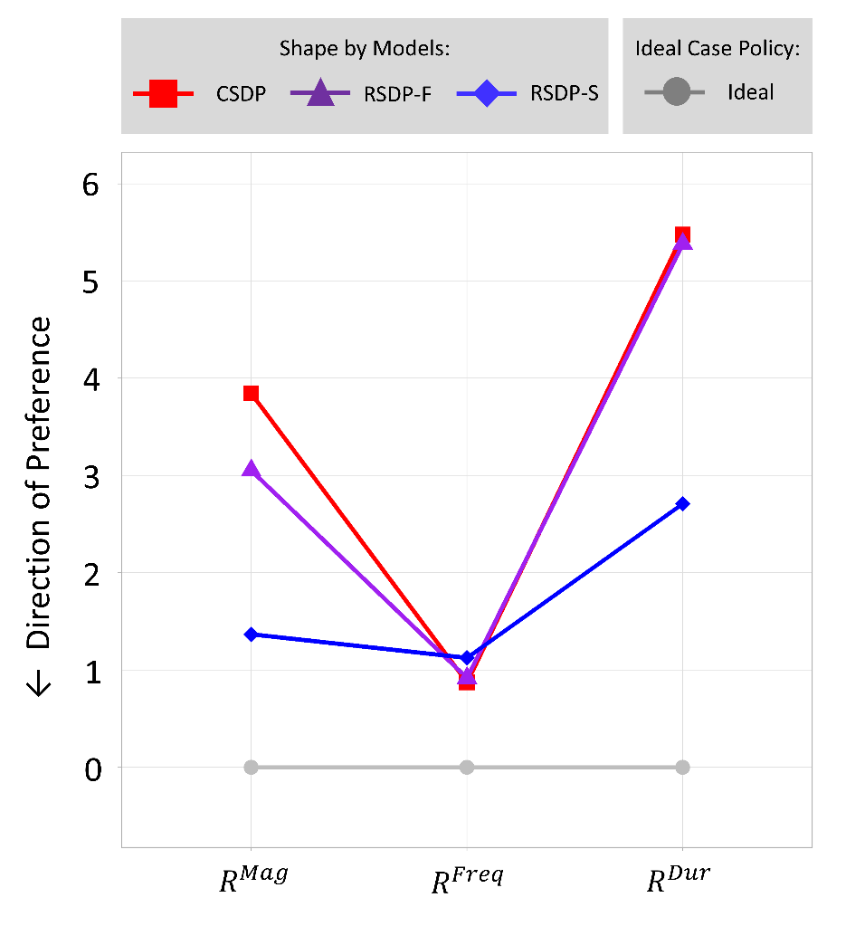

C6. Improving the Robustness of Reservoir Operations with Stochastic Dynamic Programming
Regret-based Robustness Metric: $R_{model}^{i}$
Measures the 90th percentile deviation from the average performance using the baseline scenario
Notes:
Finally, this shows the performance measured in regret-based robustness metric, which measures the ninety-th percentile deviation from the average performance using the baseline scenario.
((ANIMATION)) The result imply that the RSDP-S model is about twice better than the CSDP model measured in terms of robustness in magnitude and duration.

Slide 24
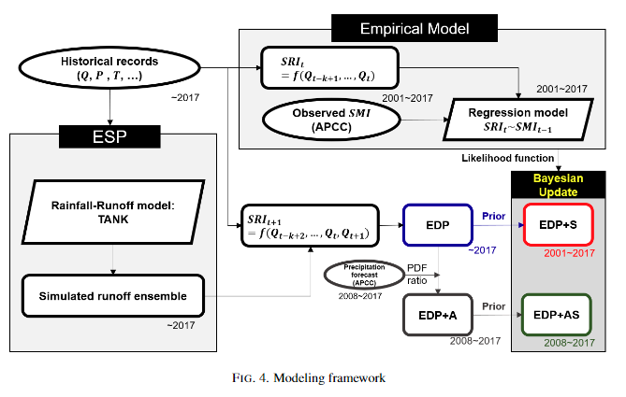
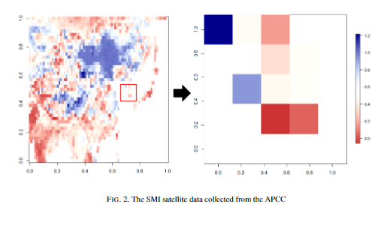
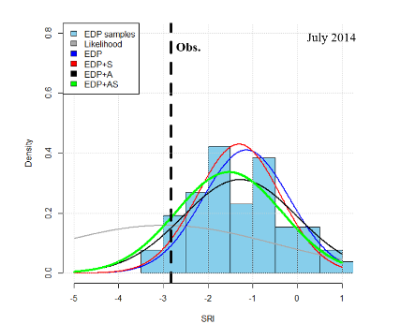
Ongoing Research Topics
Improvement in probabilistic drought prediction method reflecting drought-related information
Development of hydrological drought prediction method with ensemble drought prediction (EDP)
Precipitation forecast + soil moisture -> update the prior EDP (Bayesian)
Results of the Bayesian update were named as EDP+A and EDP+AS
Performance evaluated with RMSE, ranked probability skill score (RPSS), Brier skill score (BSS)
Notes:
Reliable drought prediction should be preceded in order to respond properly to potential droughts. Therefore, this study developed a hydrological drought prediction method in order to reflect drought-related information with the ensemble drought prediction (EDP). The ensemble of the standardized runoff index (SRI) was generated by converting the ensemble streamflow prediction results and was used as the prior distribution. Then, precipitation forecast and soil moisture were used to update the prior EDP. First, the precipitation forecast was included in the EDP with the PDF-ratio method, and yielded the result named as EDP+A. The observed soil moisture index (SMI) was reflected in the EDP and EDP+A via the Bayes' theorem with a likelihood function that is formed by a linear regression model that describes the relationship between the observed SRI and SMI. Then, the results of the Bayesian update were named as the EDP+A and EDP+AS. Eight basins in Korea where dams have been operated over 30 years were selected to test the proposed methodology. As a result, the overall performance of the four EDP is better than the climatological prediction, but it became worse when trying to predict severe drought. Nonetheless, it was found that reflecting the soil moisture information was effective in every season, and the precipitation forecast was so during only non-irrigation period of Korea. This is thought because the forecast data adopted in this study was accurate during non-irrigation period.

Slide 25
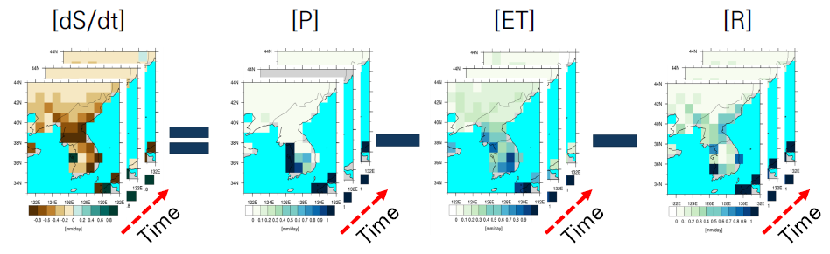
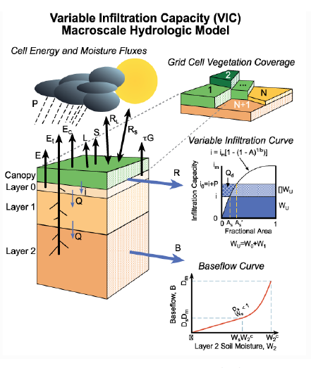
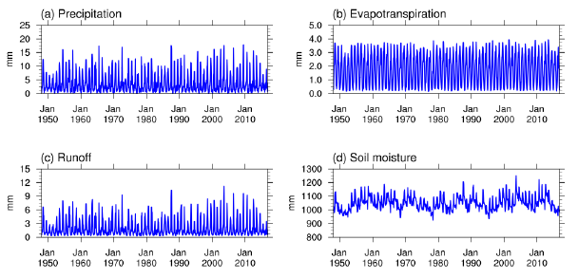
Ongoing Research Topics (Co-work)
Relief of water shortage in western Chungcheongnam-do by regenerating inflow and improving water supply adjustment standards

Slide 26
For more,
Related Publications
C4: Kim, G. J., & Kim, Y.-O.* (2021). How does the coupling of real-world policies with optimization models expand the practicality of solutions in reservoir operation problems? Water Resources Management, 35, 3121-3137. https://doi.org/10.1007/s11269-021-02862-y
C5: Kim, G. J., Seo, S. B., & Kim, Y.-O.* (in press). Adaptive Reservoir Management by Reforming the Zone-based Hedging Rules against Multi-year Droughts. Water Resources Management.
C6: Kim, G. J., Kim, Y.-O.*, & Reed, P. M. (2021). Improving the robustness of reservoir operations with stochastic dynamic programming. Journal of Water Resources Planning and Management, 147(7),04021030. https://doi.org/10.1061/(ASCE)WR.1943-5452.0001381
My personal webpage: https://gijookim.info/
Meet in person in Atlanta, GA (EWRI 2022)

